Slide 1

LECTURE ON FOUNDATION OF INDIVIDUAL BEHAVIOR AND LEARNING IN AN ORGANIZATION
Unit 2

Slide 2
“ WE DON’T SEE THINGS AS THEY ARE, WE SEE THINGS AS WE ARE.”

Slide 3
Perception
“ The study of perception is concerned with identifying the process through which we interpret and organize sensory information to produce our conscious experience of objects and object relationship.”
“ Perception is the process of receiving information about and making sense of the world around us. It involves deciding which information to notice, how to categorize this information and how to interpret it within the framework of existing knowledge.
“ A process by which individuals organize and interpret their sensory impressions in order to give meaning to their environment”.

Slide 4
Factors influencing perception
A number of factors operate to shape and sometimes distort perception. These factors can reside in the perceiver, in the object or target being perceived or in the context of the situation in which the perception is made.

Slide 5
Factors influencing Perception
Factors in the perceiver
Attitudes
Motives
Interests
Experience
Expectations
Factors in the situation
Time
Work Setting
Social Setting
Perception
Factors in the Target
Novelty
Motion
Sounds
Size
Background
Proximity
Similarity

Slide 6
The Perceptual Process
Sensation
  An individual’s ability to detect stimuli in the immediate environment.
Selection
  The process a person uses to eliminate some of the stimuli that have been sensed and to retain others for further processing.
Organization
  The process of placing selected perceptual stimuli into a framework for “storage.”
Translation
  The stage of the perceptual process at which stimuli are interpreted and given meaning.

Slide 7
Selecting Stimuli
External factors : Nature,
Location,Size,contrast,
Movement,repetition,similarity
Internal factors : Learning,
needs,age,Interest,
Receiving Stimuli
(External & Internal)
Perceptual Process
Interpreting
Attribution ,Stereotyping,
Halo Effect, Projection
Organizing
Figure Background ,
Perceptual Grouping
( similarity, proximity,
closure, continuity)
Response
Covert: Attitudes ,
Motivation,
Feeling
Overt: Behavior

Slide 8
Perceptual organization
It is the process by which we group outside stimuli into recognizable and identifiable patterns and whole objects.
Certain factors are considered to be important contributors on assembling, organizing and categorizing information in the human brain. These are
Figure ground
Perceptual grouping

Slide 9
PERCEPTUAL GROUPING
Our tendency to group several individual stimuli into a meaningful and recognizable pattern.
It is very basic in nature and largely it seems to be inborn.
Some factors underlying grouping are
-continuity
-closure
-proximity
-similarity

Slide 10
MEANING
Perceptions differ from person to person.
Each individual perceives the same situation differently.
Group perceptions can influence one’s perception.
Individuals organise and interpret things based on their past experiences and the important values they consider important.
Employees tend to behave and act on certain things on the basis of their perception.

Slide 11
NATURE OF PERCEPTION
1) Perception is the process by which an individual gives meaning to the environment.
2) It is a cognitive and psychological process. The manner in which a person perceives the environment affects his behaviour. There can be no behaviour without perception and perception lies at the base of every human action.
3) People’s action, emotions, thoughts and feelings are triggered by their perceptions of their surroundings.

Slide 12
4) Since perception refers to the acquisition of specific knowledge about objects or events at any particular moment, it occurs whenever stimuli activate the sense organs.
5) Though perception has been defined in a variety of ways, it basically refers to the manner in which a person experiences the world.
6) Perception is an almost automatic process and works in much the same way within each individual, yet typically yields different perceptions.

Slide 13
7) A stimulus that is not perceived has no effect on behaviour.
8) Perception is a process that operates constantly between us and reality.
9) Since perception is subjective process, different people may perceive the same environment differently. So perception is like beauty, that lies in the eyes of the beholder.

Slide 14
10)Perception involves the creation of gestalts.
11)Perception is a unique interpretation of the situation, not an exact recording of the situation.
12)Perception is more complex and much broader than sensation.

Slide 15
Person Perception: Making Judgments About Others

Slide 16
Attribution Theory
When individuals observe behavior, they attempt to determine whether it is internally or externally caused.
observation
Interpretation
Attribution of cause
H
External
Distictinctiveness
L
Internal
H
External
Individual behavior
Consensus
L
Internal
H
Internal
Consistency
L
External
H –high L- Low

Slide 17
Distictiveness
Does this person
behave in
this manner
in other situation
Consensus
Do other person
Behave in the
Same manner?
Consistency
Does this person
behave
in this same
manner at other
times ?
YES
Low
Distinctiveness
NO
High
Distinctiveness
No
Low
Consensus
Yes
High
Consensus
Yes
High
Consistency
No
Low
Consistency
Internal
Attribution
External
Attribution

Slide 18
Shortcuts in judging others
Selective Perception :
People selectively interpret what they see on the basis of their interests, background, experience and attitudes.
Halo Effect :
Drawing a general impressions about an individual on the basis of a single characteristics.

Slide 19
Contrast Effect :
Evaluation of a person’s characteristics that are effected by comparisons with other people recently encountered who rank higher or lower on the same characteristics.
Projection :
Attributing one's own characteristics to other people.
Stereotyping :
Judging someone on the basis of one’s perception of the group to which that persons belongs.

Slide 20
IMPORTANCE OF PERCEPTION
Perception plays a very important role in shaping the personality of an individual.
Perception is central in interpreting the world around us.
Perception affects the outcome of our behaviour because we act on the basis of what we see.
Managers should be able to distinguish between a perceived world and the reality.
An understanding of perception is important to understand and control the human behaviour .

Slide 21
The importance of perception in managerial behaviour are :
i) Attitude formation: Perceiving events and people is critical in attitude formation. Perception creates a basis for our attitudes, opinions, feelings, beliefs and values.
ii) Relationship base : the manager’s relationship with others are based on perceptions of their basic natures and motivations. Managers identify the perceptual structures and implicit personality of employees before making work relations.

Slide 22
iii) Effective communication :Any message must be received and interpreted before the communication attempt is complete. Communication remains ineffective if it does not accomplish what the source intends.
iv) Employment interview :Interviewers make perceptual judgments, draw impressions and arrive at conclusions about the applicants. Thus perception is a major input in their decision.

Slide 23
v) Performance evaluation :An employee’s performance appraisal is very much dependent on the perceptual outlook. The evaluator forms a general impression of an employee’s work. Thus, the perception process significantly influences the appraisal outcome.
vi) Employee effort : In many organisations, assessment of an employee’s effort is a subjective judgment which is susceptible to perceptual distortions and bias.

Slide 24
vii)Employees loyalty :When evaluating an employee’s loyalty, a manager is involved with person’s perception. This is an important judgement that managers make about employees.
viii)Organisational goals :The interpretation and accomplishment of organisational goals again depend on the philosophies and ideologies of those who are expected to pursue them.

Slide 25
ix) Workers’ rights : The interpretation of workers’ rights and responsibilities is also dependent on the ideological motives and beliefs of managers.
x) Employees unions :Perception plays a vital role in creating a better understanding of unions by management and vice-versa.

Slide 26
DEVELOPING PERCEPTUAL SKILLS
Following attempts can be made to enhance perceptual skills.
1. Perceiving oneself accurately: One should increase awareness about self. For this, he should obtain information on how others perceive us from as many sources as possible. By knowing. Perceiving and understanding ourselves accurately, we should remove blind spots about self.

Slide 27
DEVELOPING PERCEPTUAL SKILLS….
2. Being empathic : Empathy means being able to see a situation as it is experienced by others. A manager should be sensitive to the needs of others and perceive situations from their point of view as well.
3. Having positive attitudes : A manger should see things from a positive angle, should be aware of personal biases ad should try to get rid of any negative feeling he may have of others. This will help to put things in proper perspective.

Slide 28
DEVELOPING PERCEPTUAL SKILLS….
4. Enhancing self – concept : Self-concept or a good self image is a function of how successfully we accomplish the things we attempt to do. When people perform roles where they exhibit their competence and get success, they develop a basic sense of self esteem and have positive self regard.
5. Communication more openly : Managers should be able to effectively communicate to employees so that misconceptions can be dispelled.

Slide 29
DEVELOPING PERCEPTUAL SKILLS….
6. Avoiding common biases in perceptions : Managers should try to considerably minimise their perceptual biases. They should consciously raise their level of awareness in their interactions with situations.
7. Avoiding attributions : Mangers should try to avoid making inappropriate attributions and should obtain as accurate as assessment of the situation as possible so that dysfunctional consequences can be avoided.

Slide 30
Attitudes
Formation, components of attitudes, relation between attitude and behaviour

Slide 31
Defining Attitudes
Attitude is a hypothetical construct
Cannot be directly observed – inferred from what people say and do
Attitude objects are concrete, abstract, about people, groups of people and inanimate objects
Behaviour towards objects is dependent upon attitude towards objects
Attitudes tend to persist unless something is done to change them
Attitudes can fall anywhere along a continuum from very favourable to very unfavourable.
Attitudes are directed towards some object about which a person has feelings or affect and beliefs

Slide 32
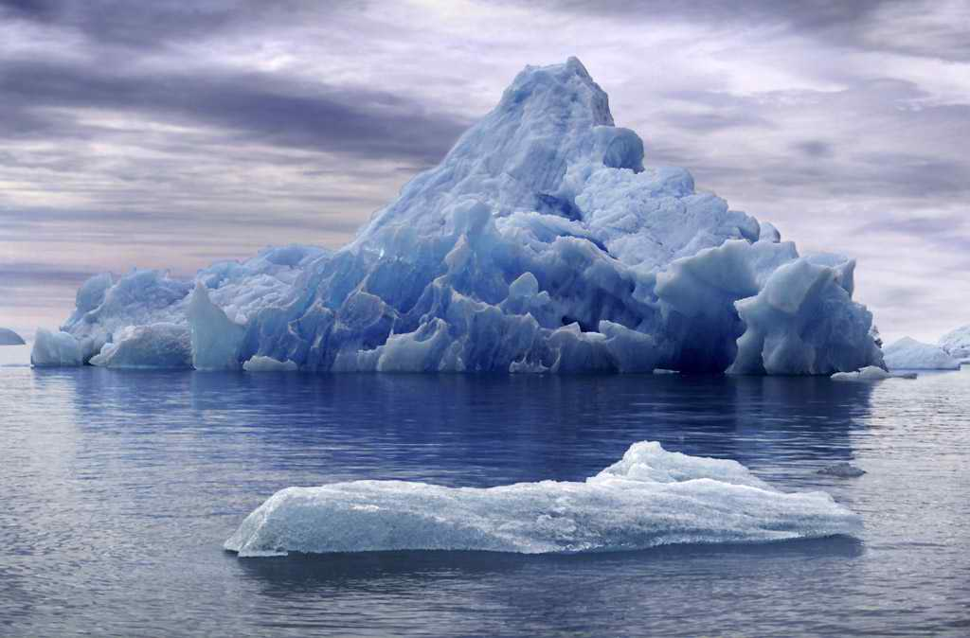
How much do you see of an iceberg?

Slide 33
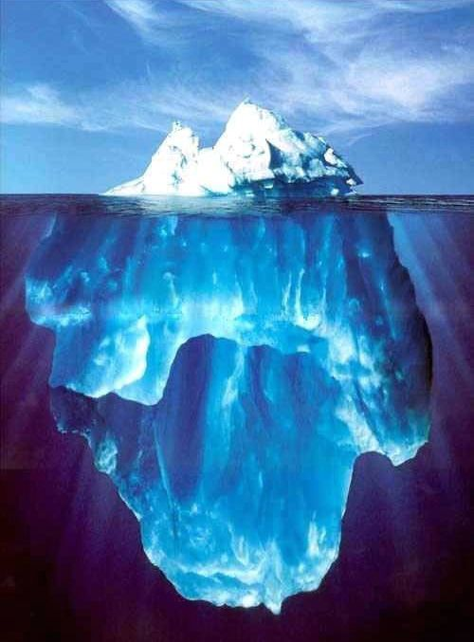
ONLY 10% OF ANY ICEBERG IS VISIBLE. THE REMAINING 90% IS BELOW SEA LEVEL.

Slide 34
BEHAVIOR
KNOWN
TO OTHERS
SEA LEVEL
UNKNOWN
TO OTHERS
IMPACT
VALUES – STANDARDS – JUDGMENTS
ATTITUDE
MOTIVES – ETHICS - BELIEFS

Slide 35
Evaluative statements or judgments concerning objects, people, or events.
Three components of an attitude:
Affective
Cognitive
Behavioral
Attitude
The emotional or feeling segment of an attitude
The opinion or belief segment of an attitude
An intention to behave in a certain way toward someone or something

Slide 36
THREE COMPONENTS OF ATTITUDES
Cognitive Component – The opinion or belief segment of an attitude.
Affective Component – The emotional or feeling segment of an attitude.
Behavioral Component – An intention to behave in a certain way towards someone or something.

Slide 37
MODERATING VARIABLES
The most powerful moderators of the attitude-behavior relationship are:
  Importance of the attitude
Correspondence to behavior
  Accessibility
  Existence of social pressures
  Personal and direct experience of the attitude.
Attitudes
Predict
Behavior
Moderating Variables

Slide 38
CHANGING ATTITUDES
Barriers to changing attitudes:
Prior commitment
Insufficient information
Methods to overcome barriers and change attitudes:
Providing new information
Use of fear
Resolving Discrepancies
Influence of friends and peers
The co-opting approach

Slide 39
WHAT ARE THE MAJOR JOB ATTITUDES?
Job Satisfaction
  A positive feeling about the job resulting from an evaluation of its characteristics
Job Involvement
  Degree of psychological identification with the job where perceived performance is important to self-worth
Psychological Empowerment
  Belief in the degree of influence over the job, competence, job meaningfulness, and autonomy

Slide 40
ANOTHER MAJOR JOB ATTITUDE
Organizational Commitment
  Identifying with a particular organization and its goals, while wishing to maintain membership in the organization.
  Three dimensions:
    Affective – emotional attachment to organization
    Continuance Commitment – economic value of staying
    Normative - moral or ethical obligations
  Has some relation to performance, especially for new employees.
  Less important now than in past – now perhaps more of occupational commitment, loyalty to profession rather than a given employer.

Slide 41
AND YET MORE MAJOR JOB ATTITUDES…
Perceived Organizational Support (POS)
  Degree to which employees believe the organization values their contribution and cares about their well-being.
  Higher when rewards are fair, employees are involved in decision-making, and supervisors are seen as supportive.
  High POS is related to higher OCBs and performance.
Employee Engagement
  The degree of involvement with, satisfaction with, and enthusiasm for the job.
  Engaged employees are passionate about their work and company.

Slide 42
OUTCOMES OF JOB SATISFACTION
Job Performance
  Satisfied workers are more productive AND more productive workers are more satisfied!
  The causality may run both ways.
Organizational Citizenship Behaviors
  Satisfaction influences OCB through perceptions of fairness.
Customer Satisfaction
  Satisfied frontline employees increase customer satisfaction and loyalty.
Absenteeism
  Satisfied employees are moderately less likely to miss work.

Slide 43
MORE OUTCOMES OF JOB SATISFACTION
Turnover
  Satisfied employees are less likely to quit.
  Many moderating variables in this relationship.
    Economic environment and tenure
    Organizational actions taken to retain high performers and to weed out lower performers
Workplace Deviance
  Dissatisfied workers are more likely to unionize, abuse substances, steal, be tardy, and withdraw.
Despite the overwhelming evidence of the impact of job satisfaction on the bottom line, most managers are either unconcerned about or overestimate worker satisfaction.

Slide 44
Statement | True | False
I find it difficult to imitate the action of other people My true feelings, attitude or belief are usually reflected in my behavior While attending parties and social gatherings, I always try to do things which others will like I can speak on almost any topic even if I know very little about such topics I think, I am a very poor actor Sometimes, I put on a show to entertain or impress others It is difficult for me to argue for ideas which I don't agree with I often act very differently with different people in different situations I would not change my actions or attitudes in order to please others Sometimes, others think that I am experiencing stronger emotions than I really am Especially, I am not good at making others like me If I have a strong reason to be, I can straight away do that, looking others in the eye I decide myself about movies, books or music, without relying on the advice of my friends in these aspects At a party, I usually let others keep the stories and jokes going I am not always the person I seem to be

Slide 45
Answers:
Award one point each to every correct answer.
Maximum score = 15
Answer key: 1-F, 2-F, 3-T, 4-T, 5-F, 6-T, 7-F, 8-T, 9-F, 10-T, 11-F, 12-T, 13-F, 14-F, 15-T
If your total score is 8 or more, you are probably high in self monitoring

Slide 46
Personality
Personality - meaning, formation, determinants, traits of personality, Big five and MBTI
personality attributes influencing OB.

Slide 47
Definition of Personality
Personality - A relatively stable set of characteristics that influences an individual’s behavior
According to Sciffman and Kanuk,
” Personality can be defined as those inner psychological characters that determine and reflect how a person responds to his or her environment.”
Notes:
6
6
6
6

Slide 48
Abstractedness: Imaginative versus practical
Apprehension: Worried versus confident
Dominance: Forceful versus submissive
Emotional Stability: Calm versus high strung
Liveliness: Spontaneous versus restrained
Openness to Change: Flexible versus attached to the familiar
Perfectionism: Controlled versus undisciplined
Privateness: Discreet versus open
Reasoning: Abstract versus concrete
Rule Consciousness: Conforming versus non-conforming
Self-Reliance: Self-sufficient versus dependent
Sensitivity: Tender-hearted versus tough-minded.
Social Boldness: Uninhibited versus shy
Tension: Impatient versus relaxed
Vigilance: Suspicious versus trusting
Warmth: Outgoing versus reserved

Slide 49
Personality Determinants:
Heredity
Environment
Culture
Situation
Life experiences

Slide 50
Formation of personality : Freudian Theory
Id
  Warehouse of primitive or instinctual needs for which individual seeks immediate satisfaction
Superego
  Individual’s internal expression of society’s moral and ethical codes of conduct
Ego
  Individual’s conscious control that balances the demands of the id and superego

Slide 51
How is Personality Measured?
Projective Test - elicits an individual’s response to abstract stimuli
Behavioral Measures - personality assessments that involve observing an individual’s behavior in a controlled situation
Self-Report Questionnaire - assessment involving an individual’s responses to questions
Myers-Briggs Type Indicator (MBTI) - instrument measuring Jung’s theory of individual differences.
Notes:
16
16
16

Slide 52
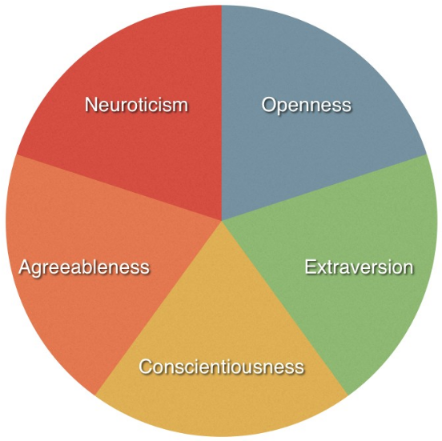
Big Five Personality Traits

Slide 53
Big Five Personality Traits
Notes:
8
8
8

Slide 54
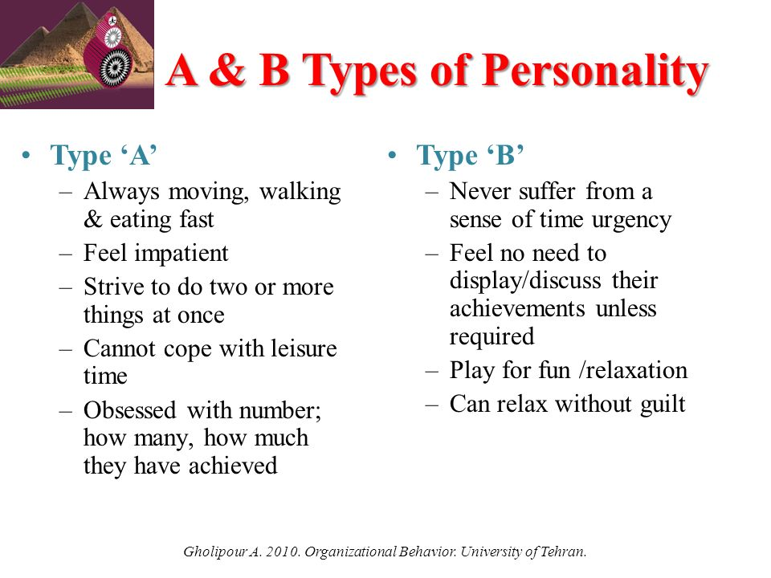

Slide 55
Myers-Briggs Type Indicator
Based on Carl Jung’s work
  People are fundamentally different
  People are fundamentally alike
  People have preference combinations for extraversion/introversion, perception, judgment
Briggs & Myers developed the MBTI to understand individual differences
Notes:
17
17
17

Slide 56
MBTI Preferences
Notes:
18
18

Slide 57
Personality Characteristics in Organizations
Locus of Control
Internal
External
I control what
happens to me!
People and circumstances control my fate!
Notes:
9
9
9
8

Slide 58
Personality Characteristics in Organizations
Self-Efficacy - beliefs and expectations about one’s ability to accomplish a specific task effectively
Sources of self-efficacy
  Prior experiences and prior success
  Behavior models (observing success)
  Persuasion
  Assessment of current physical & emotional capabilities
Notes:
10
10
10
9

Slide 59
Personality Characteristics in Organizations
Self-Esteem
Feelings of Self Worth
Success tends
to increase
self-esteem
Failure tends
to decrease
self-esteem
Notes:
11
11
11
10

Slide 60
Personality Characteristics in Organizations
Self-Monitoring
Behavior based on cues from people & situations
High self-monitors
  flexible: adjust behavior according to the situation and the behavior of others
  can appear unpredictable & inconsistent
Low self-monitors
  act from internal states rather than from situational cues
  show consistency
  less likely to respond to work group norms or supervisory feedback
Notes:
12
12
12
11

Slide 61
Personality Characteristics in Organizations
Positive Affect - an individual’s tendency to accentuate the positive aspects of oneself, other people, and the world in general
Negative Affect - an individual’s tendency to accentuate the negative aspects of oneself, other people, and the world in general
Notes:
13
13
13
12

Slide 62
Personality Characteristics in Organizations
A strong
situation can
overwhelm the effects
of individual personalities
by providing strong cues
for appropriate
behavior
Notes:
14
14
14
13

Slide 63
Personality Characteristics in Organizations
Strong
personalities
will dominate
in a weak
situation
Notes:
15
15
15
14

Slide 64

Learning

Slide 65
Learning
Learning can be defined as the permanent change in behavior due to direct and indirect experience.
It means change in behavior, attitude due to education and training, practice and experience.
It is completed by acquisition of knowledge and skills, which are relatively permanent.
Learning has taken place if an individual behaves, reacts, respondents as a result of experience in a manner different from the way he formerly behaved.

Slide 66

Types of learning
The three major types of learning described by behavioral psychology are:
classical conditioning
operant conditioning
observational learning.

Slide 67
Learning
2.4.1. Types of learning
2.4.2. Strategies of reinforcement, punishment and extinction )
2.4.3. Theories of Learning

Slide 68
Nature Of Learning
➢ Learning involves a change in behavior, though this change is not necessarily an improvement over previous behavior. It has the connotation of improved, but bad habits, prejudices , stereotypes and work restrictions are also learned.
➢ The behavioral change must be relatively permanent. Any temporary change due to fatigue or nay reason is not a part of learning.
➢ The behavioral change must be based on some form of practice or experience. Thus, any behavioral change because of physical maturation is not learning.
➢ The practice or experience must be reinforced in order for learning to occur. If reinforcement does not accompany the practice or experience , the behavior will disappear.

Slide 69
Factors Affecting Learning
There are various factors affecting individual’s learning:
Motivation
Mental set
Nature of learning materials
Practice
Environment

Slide 70
Learning Theories
There are four theories to learning:
•Classical conditioning
•Operant conditioning
•Cognitive learning theory
•Social learning theory

Slide 71
CLASSICAL CONDITIONING THEORY
Classical conditioning: acquiring a new response (the conditioned response) to a previously neutral stimulus (the conditioned stimulus) that reliably signals the arrival of an unconditioned stimulus.
Ivan Pavlov: Russian physiologist who initially was studying digestion; first identified mechanisms of classical conditioning Also known as Pavlovian or Respondent Conditioning

Slide 72
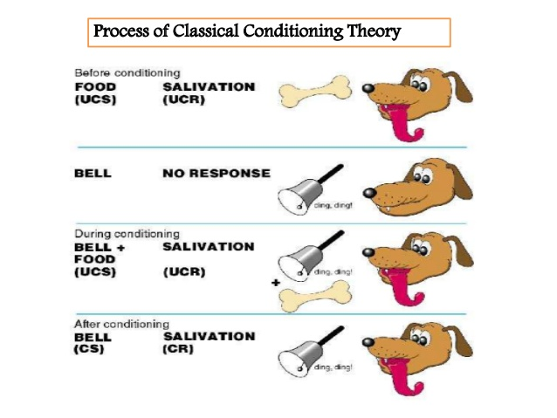

Slide 73
OPERANT CONDITIONING (INSTRUMENTAL LEARNING)
• Operant conditioning investigates the influence of consequences on subsequent behavior.
• Operant conditioning investigates the learning of voluntary responses.
• It is the consequence that follows the response that influences whether the response is likely or unlikely to occur again.

Slide 74
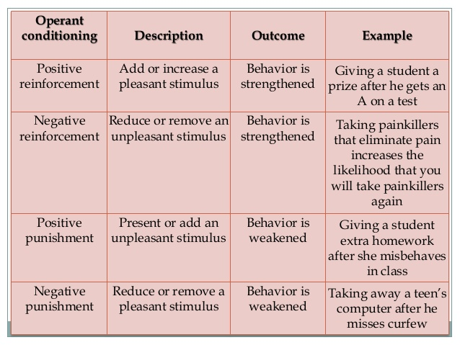

Slide 75
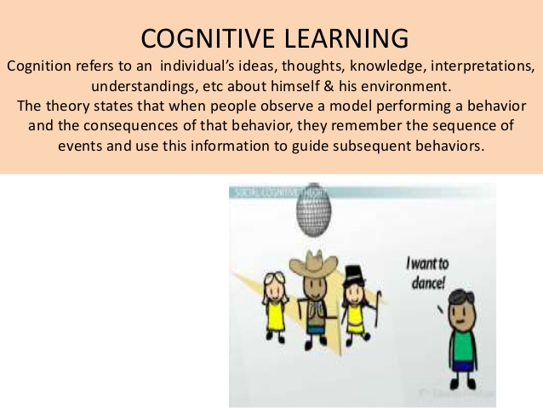

Slide 76
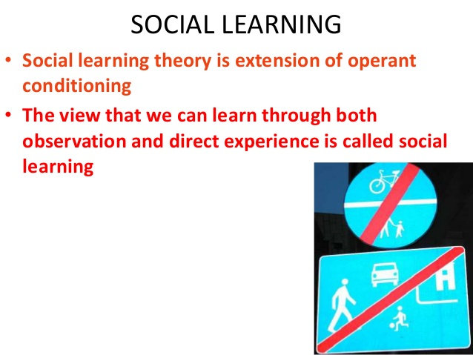

Slide 77
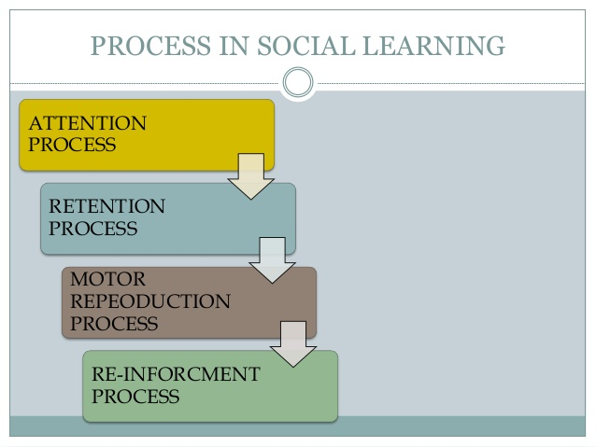

Slide 78
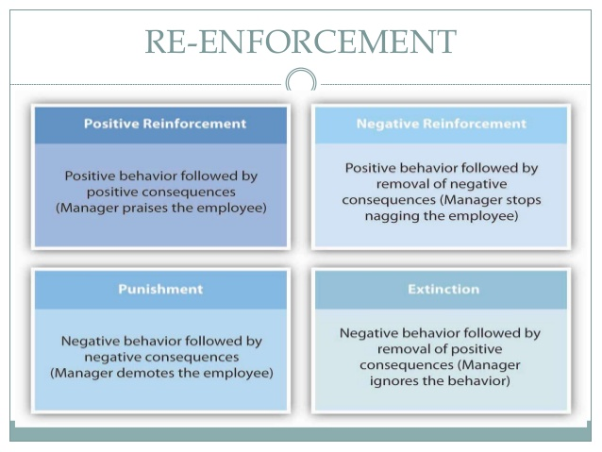

Slide 79
APPLICATION OF LEARNING IN ORGANIZATIONS
 USE OF ATTRACTIVE PRIZES TO REDUCE ABSENTEEISM: - Absenteeism reduced to a large extent and workers displayed a sense of responsibility that led to increased productivity and higher job satisfaction.
 WORK PAY VR SICK PAY  If sick leave can be converted in to payment of bonus up to a certain extent, the employees would choose to avail of financial benefits and would not absent themselves under the pretext of being sick. This will improve satisfaction level of employees and would not hamper productivity.
TRAINING AND DEVELOPMENT  Train to adapt to new working atmosphere.

Slide 80
 MENTORING PROGRAMMERS: -  Mentors need display model behavior so that subordinates emulate them. Mentors should ensure to develop sense of responsibility amongst the subordinates who should be able to take higher jobs and work for the organization. They are expected to develop positive attitude towards subordinates. This can be achieved by full dedication on the part of both mentor and the trainee.
 DISCIPLINE: -  In organization be it production intensive or service sector, managers should insist that all his subordinates strictly follow the timing of work, dress code, display courteous behaviour when interacting with others and accomplish their assigned task on time. Defaulters should be dwelt with strictly. Any lethargy in programme implementation will not bring behaviour modification.
 SELF-MANAGEMENT: -  Regulating various activities and achievement of personal as well as organizational goals would be easier in an environment of self managed organizations.

